Slide 1
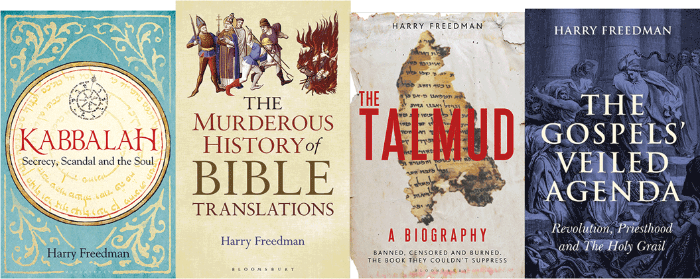
The Strange Story of Christian Kaballah
Harry Freedman www.harryfreedmanbooks.com

Slide 2
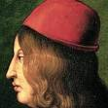
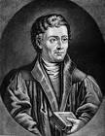
Count Giovanni Pico della Mirandola. 1463-1494
  Mithridates(Samuel ben Nissim Bulfarag)
1486 Conclusiones:-
There is no greater knowledge capable of proving the divinity of Jesus than magic and Cabala
Johannes Reuchlin 1455-1522
1494 De Verbo Mirifico, On the Miraculous Word
1517 De Arte Cabalistica
Cardinal Egidio da Viterbo 1472-1532
Francesco Giorgi- 1466-1540 De Harmonia Mundi
Harry Freedman www.harryfreedmanbooks.com

Slide 3
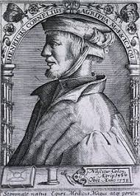
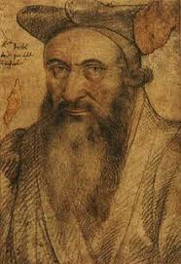
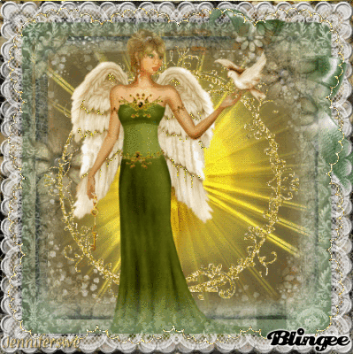
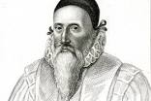
Heinrich Cornelius Agrippa 1486-1535
1533 De Occulta Philosophia
Guillaume Postel 1510-1581
John Dee 1527-1608
Harry Freedman www.harryfreedmanbooks.com

Slide 4
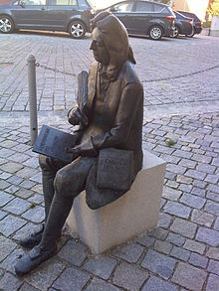
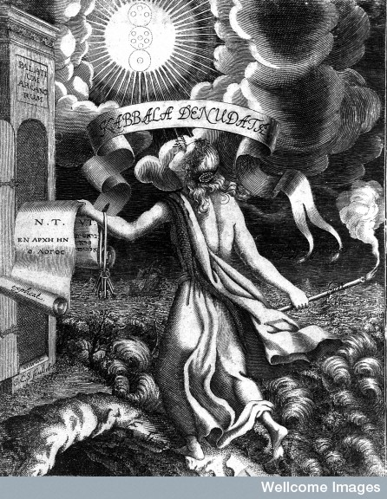
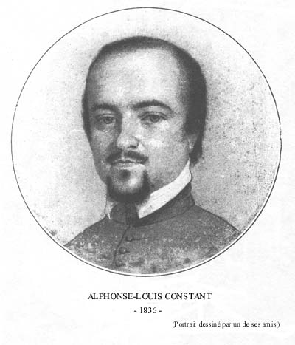
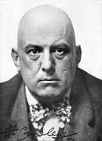
Christian Knorr Von Rosenroth 1636-1689
1677 Kabbala Denudata
Eliphaz Levi 1810-1875
Hermetic Order of the Golden Dawn 1887
Aleister Crowley 1875-1947
Harry Freedman www.harryfreedmanbooks.com

